Slide 1
Potentially habitable planets
By:
Douglas High, Eric Viera, Jeffrey Hoffman,
Joonil Kim, and Melissa Torres

Slide 2
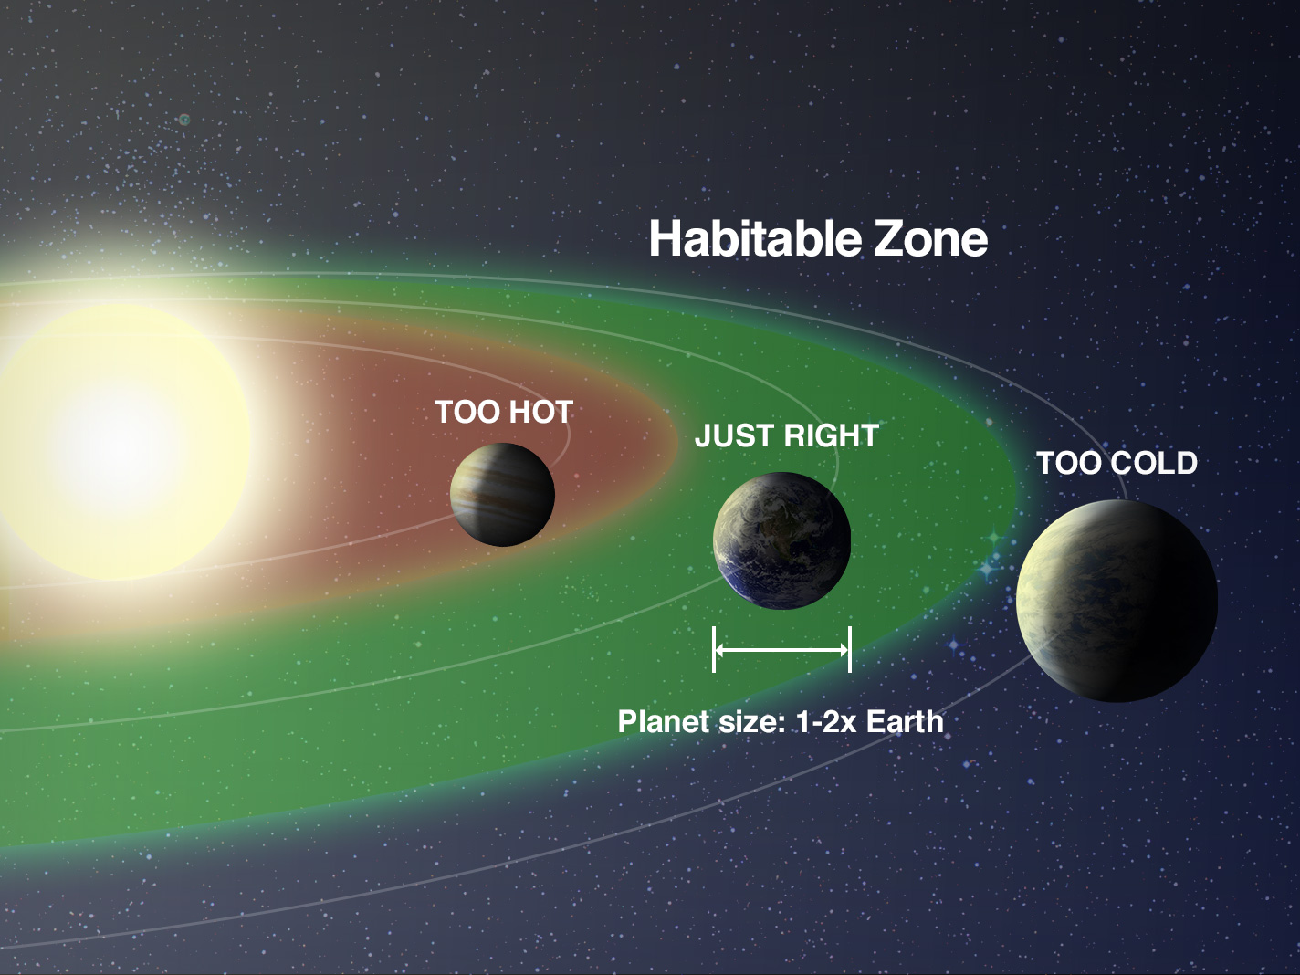
The Search is On
Currently 4000+ known exoplanets in the visible universe
200 Planets considered optimistically Habitable
NASA and astronomers have collected information including:
Size and density of these known planets
How far from their host star(s) they orbit
How much energy their star(s) emit among other information
Notes:
To find another planet like Earth, astronomers are focusing on the 'habitable zone' around stars--where it's not too hot and not too cold for liquid water to exist on the surface

Slide 3
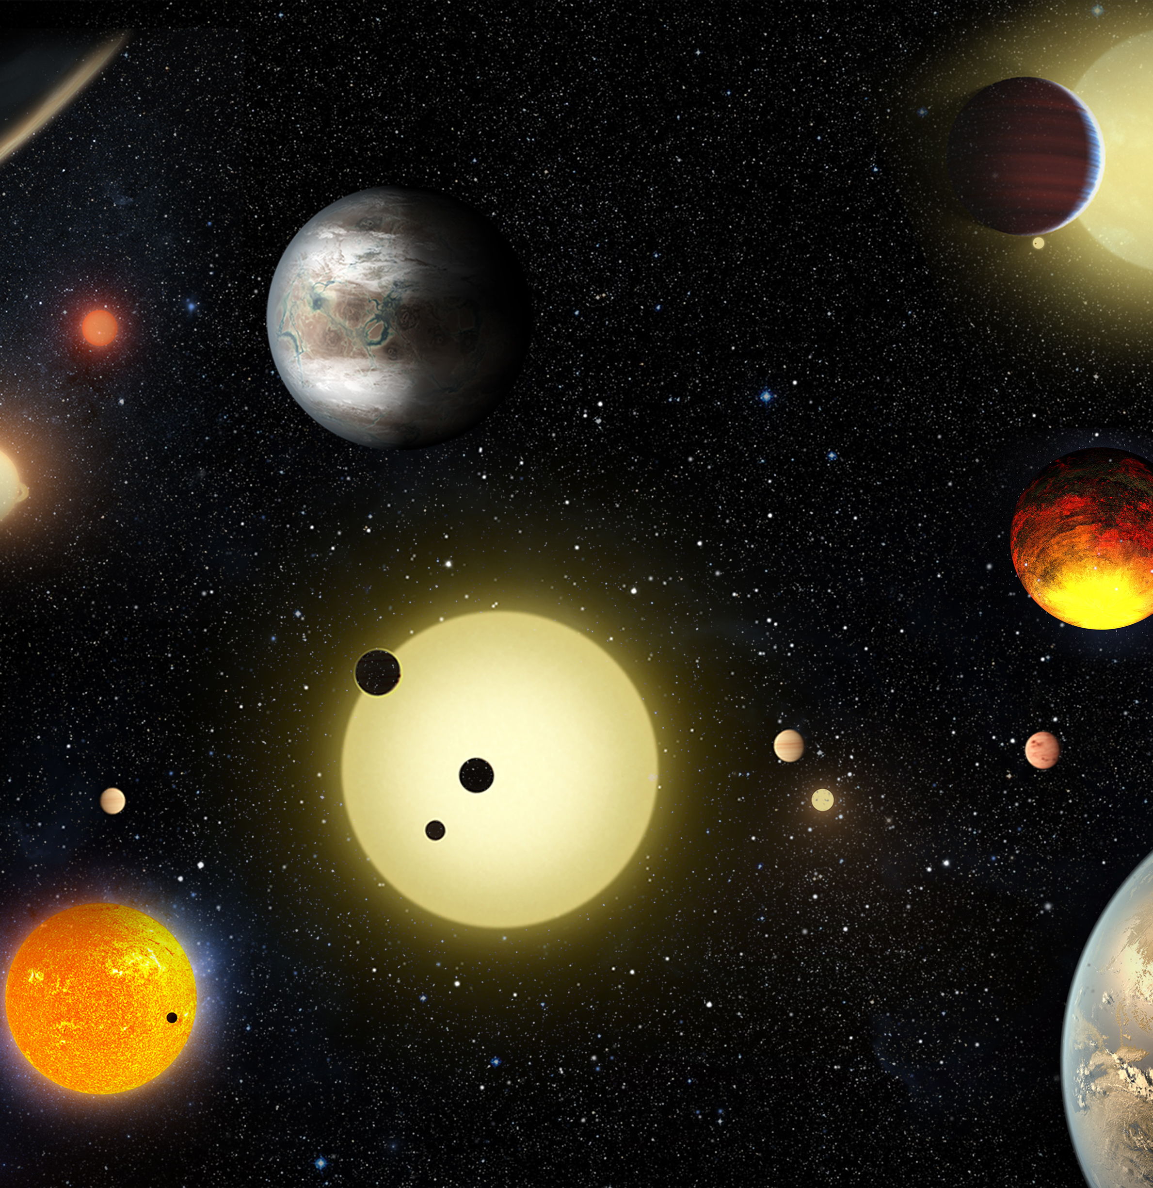
Objectives:
Interactive graphs/plots visualizing info about known exoplanets including:
Optimistically habitable planets capable to host life
Types of Planets
Planet Discovery Years and Methods
Size, density, temperature, composition, solar system data, galactic locations and distance from earth
Leaflet of Facilities across the world that discovered planets
Notes:
To find another planet like Earth, astronomers are focusing on the 'habitable zone' around stars--where it's not too hot and not too cold for liquid water to exist on the surface

Slide 4

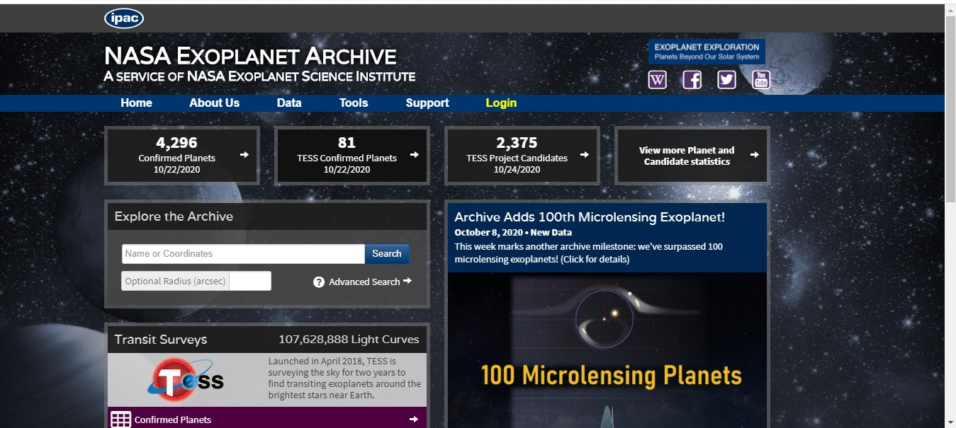
Data Sources:
Planetary Habitability Laboratory @ UPR (http://phl.upr.edu/)
NASA Exoplanet Archive (http://exoplanetarchive.ipac.caltech.edu)

Slide 5
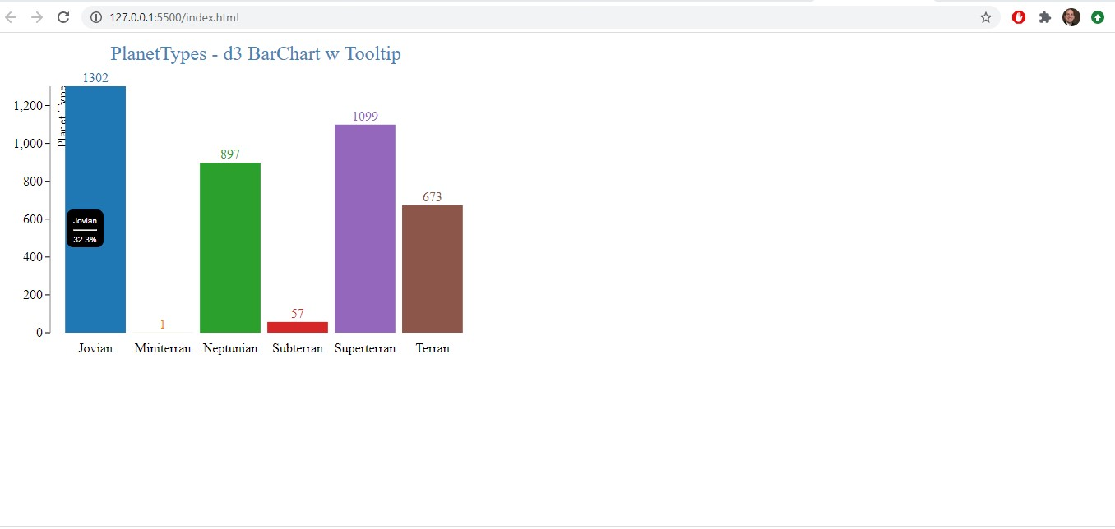
Planet Types – D3 Barchart w Tooltips
4 main types of Planets
Jovian
32.3%
Superterran
27.27%
Neptunian
22.3%
Terran
16.7%

Slide 6
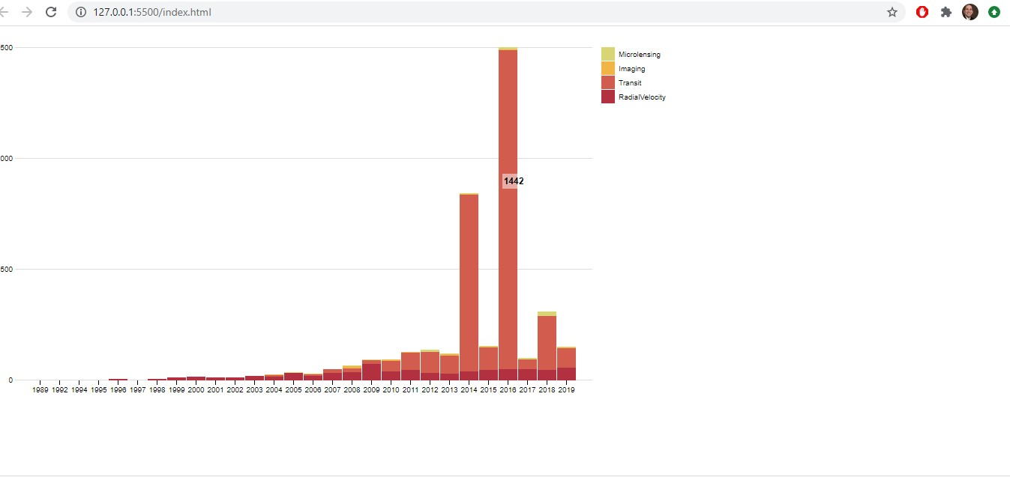
StackedChart – Planet Discovery Method by Years
2014 & 2016 big spikes in discovered planets via Transit method
2014
798 planets discovered by Transit method
2016
1442 planets discovered by Transit method

Slide 7
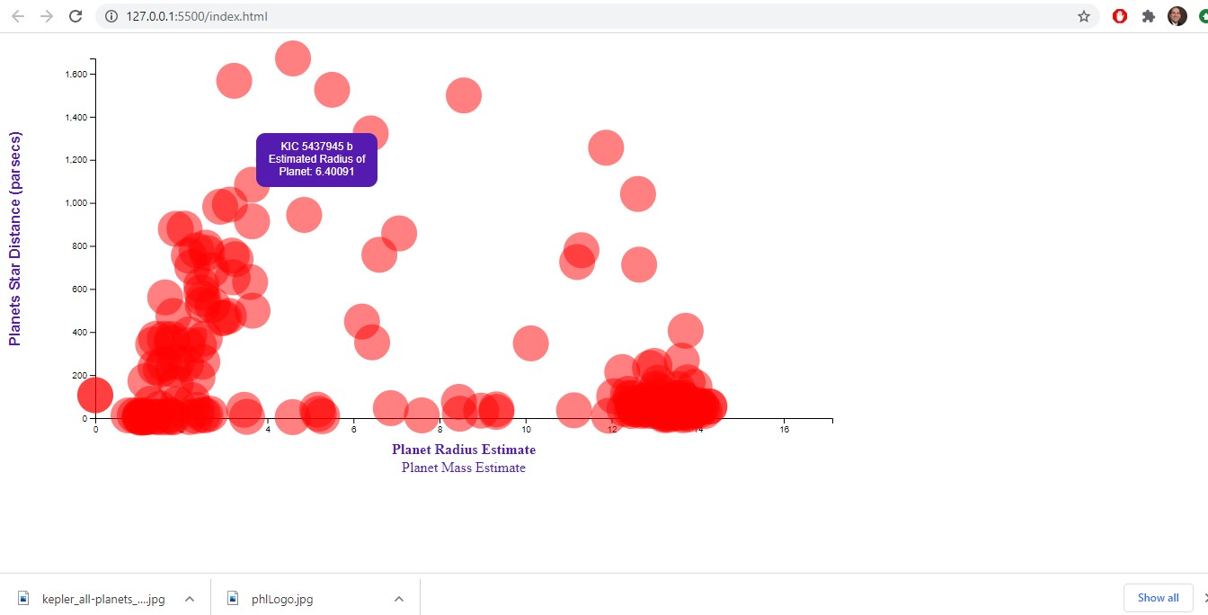
D3 - Planets Mass / Radius Est vs Star Distance

Slide 8
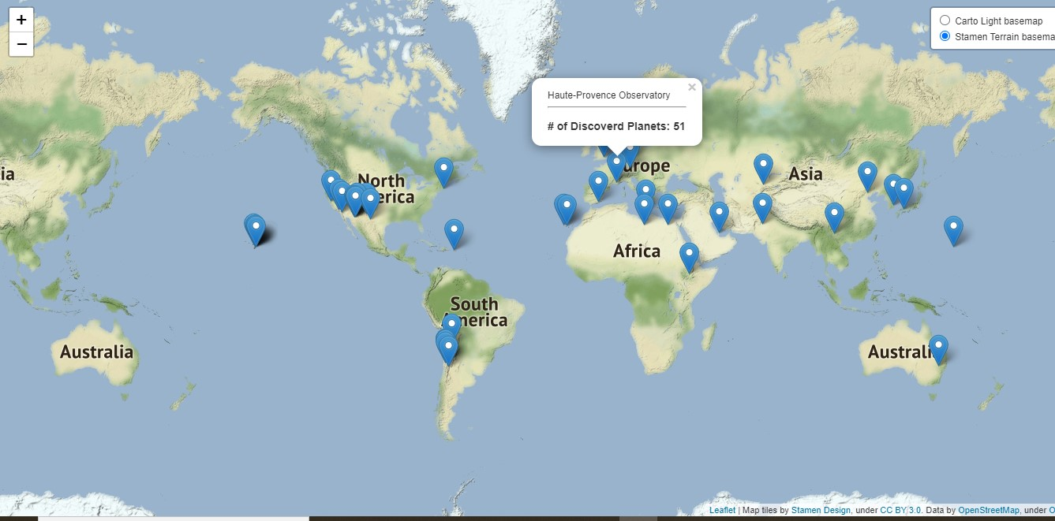
Leaflet of Facilities that Discovered Planets

